Slide 1
Monitoring and Control

Slide 2
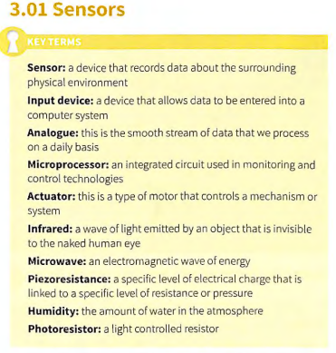
Sensors

Slide 3
Sensor cont….
A sensor is an input device that records data about the surrounding physical environment. The sensor inputs this data into a computer system to be processed. Once the data has been processed, if necessary, an output can be triggered as a response.
TIP Sensors can automatically enter data into a computer system, removing the need for a human to manually enter the data. They can be very beneficial as it can increase the accuracy of the data by removing the possibility of hum an error.
Using sensors can also be very beneficial in environments that could be harmful and dangerous for a human, for example in a nuclear plant to detect radiation levels, or inside an active volcano to detect changes in activity. Monitoring and control technologies make use of many different sensors. Monitoring technologies use sensors to monitor an environment, often collecting data about the environment.

Slide 4
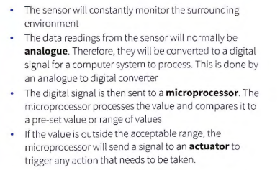

Slide 5
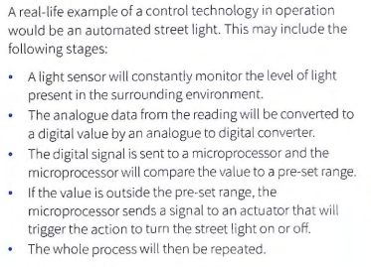
Sensor

Slide 6
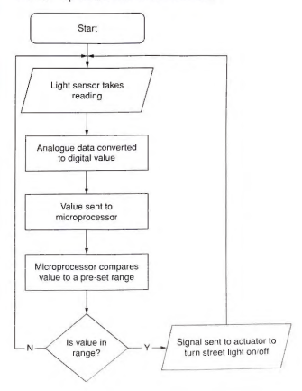
sensor

Slide 7
Assignment 1: Give at least 3 examples of each application software discussed in class
Assignment 2:
Using Command prompt : create a folder in MY DOCUMENT call it ICT001-folder copy any files from your desktop into the file (using CMD only). Write the steps of how you accomplish the task
Assignment 3:
Draw a simple flowchart for the assignment two above
Submission Date: assignment 1,2,3 all should be submitted by nextweek Monday 11-11-2024

Slide 8
Motion Sensor
Motion sensors
A motion sensor detects movement. It can do this either passively or actively . A passive motion sensor reads the energy in its surrounding environment and detects changes caused by movement. An active motion sensor emits energy into the surrou nding enviro nment to detect any movement. An example of a passive motion sensor is a passive infrared senso r.
This is a sensor that detects the presence of infrared energy if it appears in its surrounding enviro nment. An exam ple of an active motion sensor is a microwave sensor. This is a sensor that emits microwaves and detects the changes in th e reflection it receives back when bounci ng off nearby objects .
Passive infrared sensors are commonly used in security systems. These sensors are normally wall mounted in the corner of a room. As an intruder walks in front of a sensor, the sensor detect s the infrared energy emitted by the intruder. The dete ct ion of infrared energy by the sensor can then trigger an alarm to sound .
Active motion sensors can also be used in security systems. A microwave sensor cont inuou sly emits microwaves into a room. As an intruder walks through the microwaves, they will be reflected back much more qu ickly to the sensor and it will detect the change. This change in reflection of the microwaves can then cause an alarm to sound

Slide 9
Motion Sensor
Motio n senso rs can be used in lots of other monitoring and control systems. These include:
CCTV system s, to manoeu vre th e cam era to th e direction
of motion that is detected
opening and closing automatic doors
automa tically turning lights on or off in a room when a
person enters or leaves
automatically turning wa ter taps on or off
automat ed barriers in a car park.

Slide 10
Pressure sensors
A pressure sensor measures pressure, normally of a liquid or a gas. The measure of pressure is based upon the force it takes to stop a liquid or gas from expanding. Most modern pressure sensors use a principal called piezoresistance . In piezores istance , a specific level of press ure is linked to a spec ific level of charge through a substance . If a change in the level of charge is detected, thi s is interpreted as a change in pressure. Pressure sensors can be used in things such as pipes to measure the flow of liquid or gas through them, to make sure they do not flow too quickly.

Slide 11
Pressure Sensor
Pressure sensors can be used in many different monitoring and control technologies. These include:
The vehicle industry: They are used to form part of the
safety system of a vehicle. Pressure sensors are used
to mon itor the oil and coolant in the vehicle. They are
used to regulat e the power given to the engine based
on the pressure placed on the accelerator and brake.
The airbag safety system also uses pressure sensors.
The air bags will be triggered to inflat e when a high
amount of pressure is app lied to certain part s of the
vehicle.

Slide 12
Pressure Sensor
Chemical and nuclear plants. They are used to monitor and control the flow of gases and liquids in industrial plants. This means that substances that are being transported in the plant, or any chemical reactions that are carried out, are done extremely safely. This makes sure that a high level of safety is maintained in the industrial plant at all ti mes.
Aviation and marine industry. They are used to monitor and con tro l the atmosphere within an aeroplane or submarine. This is to make sure that the correct breat hing conditions are maintained .
Touch screens. A touch screen that uses pressure sensors is built up of mu lti ple layers. When pressure is applied to the top layer of the screen it is pushed into the bott om layer of the screen, creating a connection that generates an electrical signal. This electrical signal informs the device of the location where the pressure has been app lied to the screen.

Slide 13
Moisture and humidity sensors
Humidity sensors monitor and measure the humidity that is in the air. To monitor the humidity they measure both the moisture and temperature in the air. The percentag e of moisture present in the air at a certain
temperature is expressed as the level of humidity. Humidity sensors normally use capac itive measurement. This type of measurement uses two electrical conductors that have a non-conductive film separating them. Moisture collects on the film and changes the level of volt age between the electrical conductors .
The measurement of the change in voltage is converted into a measurement of humidity. Humidity sensors can be used both in the home and the workplac e to monitor and control humidity levels, including :

Slide 14
Application of Moisure and Humidity Sensor
Wine cellars. The humidity level in the atmosphere of a wine cellar is very important. Too much or too little humidity can cause the wine to spoil. The humid ity level needs to be kept at a constant and correct level in order to keep the wine at its best.
Meteorological stations. They are used to help monitor and predict weather conditions by measuring humidity levels.
Controlling allergies. An atm osphere that is high in hum idity can encourage the growth of bacteria and mould . This can trigger allergies. Humidity sensors can be used to monito r and control the level of humidity in a room .
Manufacturing. In the manufacturing of many products the level of moisture in the atmosphere is very impo,iant. If humidity is too high or too low it could adversely effect the product.

Slide 15
Temperature sensors
Temperature sensors monitor and measure the
temperature of an env iro nment. They do this by measuring how much heat is present. Temperature
sensors are used in a great number of control systems, many of them in our home appliances. These
include:

Slide 16
Application of Temperature Sensor
Washing machi ne and dishwasher. A temperature sensor is used in a washing machine and a dishwas her to measure th e temperature of the water. A microproc essor in the washi ng mach ine or dishwasher will receive th e data sent by the tem perature sensor and can trigger an action to heat up or cool down the water if necessary .
Dryer. A temperat ure sensor is used in a dryer to measure the temperat ure of th e hot air flowing into the dryer. A mic roprocesso r in the dryer wi ll receive the data sent by the tempera ture sensor and can tri gger an action to heat up or cool down the air if necessary.
• Refrigerato r and freezer. A temperatu re sensor is used in a refrigerator or freezer· to measure th e ambient tempe rature inside. A microprocessor in the refrigerator or freezer wi ll receive th e data sent by the temperature sensor and can trigger an act ion to heat up or cool down the air if necessary.

Slide 17
Light sensors
Light sensors monitor and m easure light. There are different types o f light senso r and they measure light in different ways . The mos t co mm on type of ligh t sensor is a photoresistor. Thi s ty pe of light sensor will change its resistance when light shine s on and is normally used to measure t he int ensity o f light. Th is is important indevices such as digital cameras or street lights.
The camera can adjust the level of flash needed depending on the level of light currently detected by the light sensor. A street light can detect when it gets dark enough to need to switch the light on.

